Slide 1


Scorekeeping Clinic
based on the:
Scorekeeping Clinic

Slide 2
Officials and Work Team
Common Placement
R1
L1
R1 – 1st Referee
R2 – 2nd Referee
S – Scorekeeper
LT – Libero Tracker
SO – Scoreboard Operator
L1/L2 - Linesperson
L2
R2
Team Bench
SO
S
LT
Team Bench

Slide 3
Materials Needed to Keep Score
5 Regular score sheets (3 of 5 match)
2 line-up sheets (1 for each team)
Libero tracking sheet
2 contrasting pens (recommend Black or Blue and Red)
The school should provide these materials. Bringing your own pens is never a bad idea though.

Slide 4
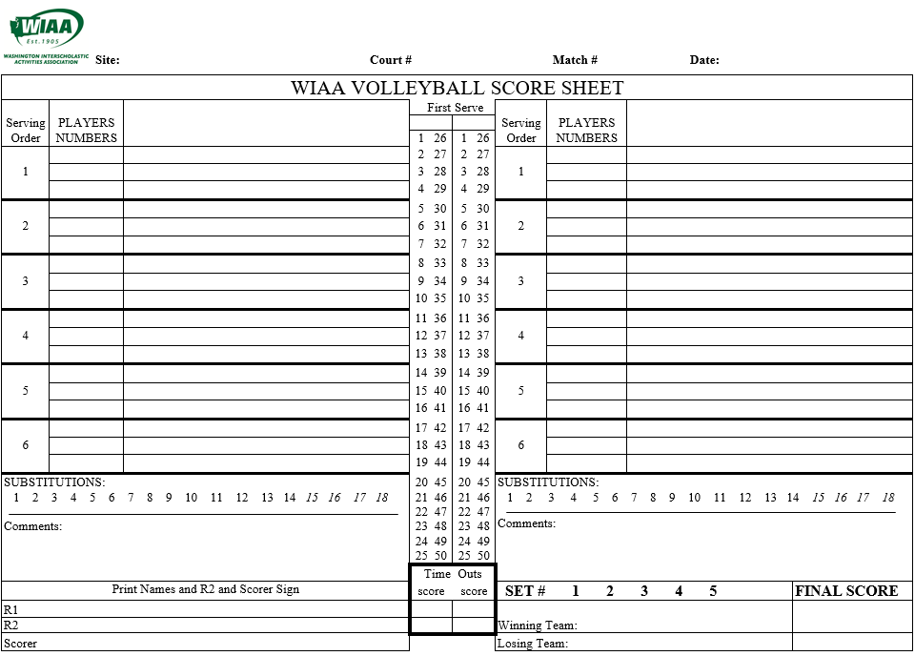
WIAA score sheet

Slide 5
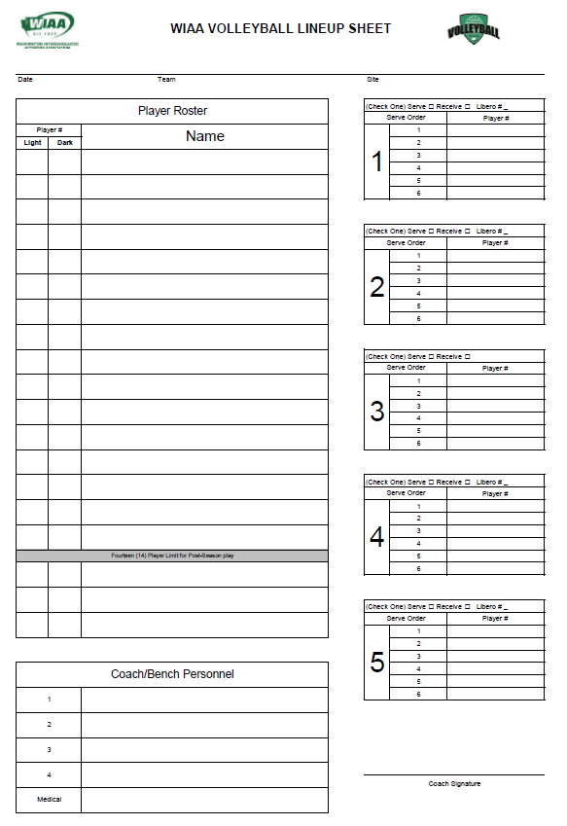

Slide 6
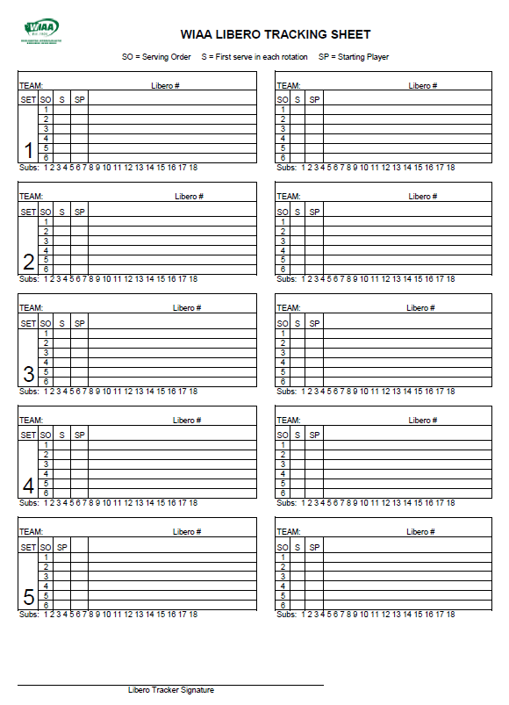

Slide 7
Instructions for the WIAA Score Sheet
PRE-MATCH
> Fill in Site, Court #, Match #, Date, names of the R1, R2, and Scorekeeper, in the appropriate spaces.
> Write team names on the correct serving side
> Circle the number of the set that is being played
> Make a mark in the box under FIRST SERVE when the official reports results of the pre-match conference
> Fill in starting player numbers, by serving order, for each team, identifying the captains with a “c”
DURING THE GAME
> At the moment of contact for serve, make a circle in the first line for the first server in the scoring column
> If the server scores a point – put the point number in the circle and circle the corresponding point in the
running score column
> If the serve results in a point for the receiving team, put an “R” in the circle, then move to the other side of the
score sheet and make a square on the first line of the next server in the scoring section – put the point number
for that team in the square and square the corresponding number in running score column for that team
> For the first serve after side out, make a circle at the moment of contact next to the square containing the side
out point – the outcome of that play goes in that circle
> Continue throughout the set with circles and squares, depending on whether the point is scored while
serving (circle) or receiving (square)
> If/When the libero serves put a triangle around the Serving Order number in the position in which she is
serving, a triangle instead of a circle when she contacts the ball, and a triangle around any corresponding
points scored in the running score column. The Libero will be able to serve only in this service position.
> When the service order comes back around to the top, switch from your black/blue pen to a red pen; if the order
goes through again, switch back to your black/blue pen, and so on

Slide 8
Instructions for the WIAA Score Sheet
SUBSTITUTIONS
> Whenever a substitution occurs the action must be recorded
> If the serving team is substituting, put an “S” where the next serve circle would go and then the number of
the player going in over the number of the player coming out (like a fraction). i.e. serving team #7 in for #17 would look like S7/17
> If the receiving team substituting, put an “Sx“ on the line of the current server where the serve next circle would go and then the number of the player going in over the number of the player coming out (like
a fraction). i.e. receiving team #6 in for #14 would look like Sx 6/14
> Circle the number of the substitution in the box marked SUBSTITUTIONS– each team is allowed 18 substitutions per game, unlimited individual and the Libero does not count as a substitution.
> Replace the player in the Players Numbers column as well by striking out the player leaving with a single slash and writing in the new player’s number next to the struck out number (do not mark libero replacements in this way – the libero tracker is responsible for the libero substitutions).
TIME OUTS
> Time outs are notated similarly to substitutions – always where the next serve circle would go regardless of
whether it is a serving team or receiving team time out, with “T” for a serving team time out and “Tx”
for a receiving team time out
> Note the score of the time out in the “time outs” portion of the score sheet – the score should be written on
the side of the team which took the time out, with their score first (ie, receiving team is losing 12-15
and takes a TO the score is reported “12-15”; if the serving team takes a TO here it is noted “15-12”
> Be careful to only use one box per time out, there are four boxes because each team gets two (it’s
easy to want to write one score across both boxes – don’t do that!)

Slide 9
Instructions for the WIAA Score Sheet
SANCTIONS
> All sanctions must be written in the comments section of the score sheet and will include the player number
or coach’s name, score at the time of the sanction, outcome of the sanction and a BRIEF description if the
situation.
END OF GAME
> Fill out Winning Team and Losing Team, and each team’s FINAL SCORE in the appropriate 4 boxes
> Scorekeeper signature
> R2 signs the score sheet at the end of the match
Code | Served | Point | Rotate | Re-play | No serve | Mind change | Libero serve | Serving team sub | Receiving team sub
Symbol in line score |  |  |  |  |  | M |  | S | Sx
3
R
P
3
Serving team TO | Receiving team TO
T | Tx

Slide 10
Practice Set Situation
The following is a set situation. As you follow along with this situation you will see the placement on the score sheet. We recommend you use pencil during this session. After each situation click the mouse to see the results, then click again to move forward.

Slide 11
You arrive at Ferris HS for the match as the scorekeeper. As you approach the table you see that you have all the appropriate materials to do your job.
Score Sheets, Lineup Sheets a black/blue pen and a red pen.
Ferris is on your right side and Shadle Park is on your left side warming up as you are seated at the table
Your officials for the match are:
R1 – Romin Referee
R2 – Sunny Day
Scorer – Your Name
You begin to fill out the score sheet for Set 1.

Slide 12
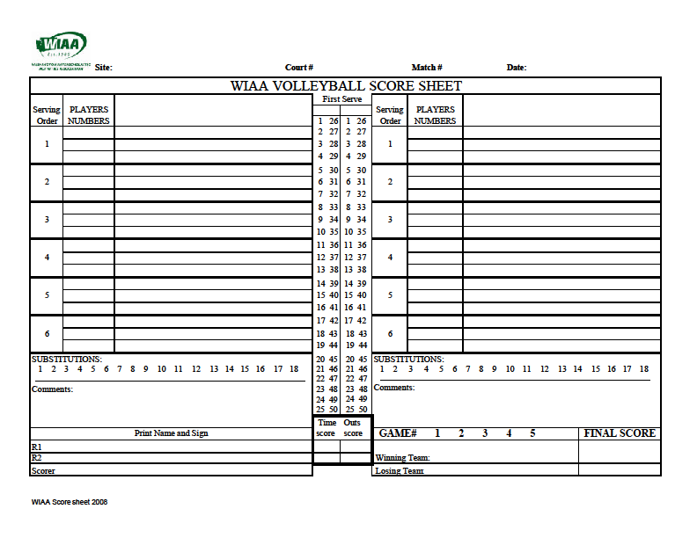
Ferris HS
1
1
Sep 11, 2009
Shadle Park
Ferris
Set #
Score
Romin Referee
Sunny Day
Your Name
WIAA Score Sheet 2009
WIAA score sheet

Slide 13
Ferris HS
1
1
Sep 11, 2009
Shadle Park
X
Ferris
Upon the completion of the coin toss the second referee tells you that Ferris is Serving.
You indicate this on the score sheet.
Set #
Score
Romin Referree
Sunny Day
Your Name
WIAA Score Sheet 2009
WIAA score sheet

Slide 14
The coach brings you the Ferris lineup sheet for the first set. You ensure that the line up sheet is approved by checking to see if there is/are:
Duplicate numbers
Numbers on the line up but not on the roster
A captain has been identified
A Libero number has been indicated if they are using one for that set. (Even though you do not indicate the Libero number on the score sheet you need to ensure the team is not using one. If the Libero is not indicated on the lineup and she comes onto the court it is a fault.) (If you want to indicate the Libero number a lot of people do in the top right of the team name box with “L#”)
You now enter the information onto the score sheet

Slide 15
9/11/09
Ferris
Ferris HS
x
19
1
3
1 1 Rebecca Quinn
5 c
7
3 3 Alicia Brown
9
5 5 Patty Rolf
11
7 7 Ginger Rogers
9 9 Georgia Smith
11 11 Roberta Bell
13 13 Gina Robeson
15 15 Betty Watkins
17 17 Kris Weather
19 19 Megan Moon
Coach Bob
Coach Pete
Coach Bob

Slide 16
Ferris HS
1
1
Sep 11, 2009
Shadle Park
X
Ferris
1
3
You input the line up just as it is printed on the line up sheet. Here is the Ferris line up.
5c
7
9
11
Set #
Score
Romin Referree
Sunny Day
Your Name
WIAA Score Sheet 2009
WIAA score sheet

Slide 17
The coach brings you the Shadle Park lineup sheet for the first set. You ensure that the line up sheet is approved by checking to see if there is/are:
Duplicate numbers
Numbers not on the roster
A captain has been identified
A Libero number has been indicated if they are using one for that set. (Even though you do not indicate the Libero number on the score sheet you need to ensure the team is not using one. If the Libero is not indicated on the lineup and she comes onto the court it is a fault.) (If you want to indicate the Libero number a lot of people do in the top right of the team name box with “L#”)
You now enter the information onto the score sheet

Slide 18
9/11/09
Shadle Park
Ferris HS
x
20
2
4
2 2 Alicia Quinn
6 c
8
4 4 Rebecca Twin
10
6 6 Sally Green
12
8 8 Suzy Thompson
10 10 Mindy May
12 12 Yolanda Rodriguez
14 14 Patty Paige
15 15 Roberta Walker
18 18 Christina Pale
20 20 Tina Hanson
Coach Sue
Coach Mary
Coach Sue

Slide 19
Ferris HS
1
1
Sep 11, 2009
Shadle Park
X
Ferris
2
1
4
3
6c
5c
The is what Shadle Parks line up should look like on the score sheet.
8
7
10
9
12
11
Set #
Score
Romin Referree
Sunny Day
Your Name
WIAA Score Sheet 2009
WIAA score sheet

Slide 20
Good Scorekeepers will fill out 2 additional sheets in preparation for the second and third sets. You can fill in the headings, the teams on the correct sides, as well as the names of the officials. Be careful not to put a lineup in though. Even if they have pre done their lineups for set 2 and 3 the coach has the opportunity to change players before having to hand it in prior to the start of each set.
The match is about to begin! As the R2 is checking the placement of each team on the court you should also be checking against your score sheet.
Before the R1 beckons for serve you check to make sure the number of the player serving is correct. It is and you continue.

Slide 21
Slash the number of the player coming out in the Player Number column on their team side and write the number of the player coming in for them.
Circle or slash the first sub below in the SUBSTITUTIONS box for the team that took the sub. (Teams are allowed 18 subs and this is how to keep track.)
Ferris HS
1
1
Sep 11, 2009
Shadle Park
X
Ferris
2
1
R
1
1
2
R
4
2
3
4
R
3
3
4
5
Tx
Sx 14/8
R
Shadle #4 serves again but loses the rally.
Ferris #3 serves the ball long.
Shadle #4 serves 2 times and scores 2 points
The coach for Shadle calls for a time out and you indicate this on the score sheet.
Indicate the timeout by putting a Tx where the next serve circle would go (Tx for the receiving team, T for the serving team).
Write their score first followed by a dash then the other teams score in the Time Out section on the teams side that called the time out.
6c
Ferris #3 serves the ball twice and scores 2 points.
5c
6
8
7
14
#1 serves again but the ball is out.
This time put an R in the circle you created
Box the first point in the running score column for the other team
Draw a box in the first line of that teams first server in the scoring column
Put the first point in that box. (The box means that team did not serve that point.)
The R1 beckons for serve and you wait. As soon as you see the server contact the ball you make a circle in the first line for the first server in the scoring column.
#1 serves again
She scores another point
#2 for Shadle Park serves the ball but it misses just wide.
She scores a point and you indicate this on the score sheet by putting the point scored in the circle you created and also circling the point in the running score column.
10
9
12
11
The timeout is over
Shadle #14 comes to the sub line and goes in for #8.
The R2 handles the sub and you enter it on the score sheet.
Since the sub is on the receiving team record on the line of the player controlling the serve a Sx followed by the number of the player entering and then the player leaving the set in the form of a fraction.
1-5
Set #
Score
Romin Referree
Sunny Day
Your Name
WIAA Score Sheet 2009
WIAA score sheet

Slide 22
Ferris HS
1
1
Sep 11, 2009
Shadle Park
X
Ferris
2
1
R
1
1
2
R
4
2
3
4
R
3
3
4
5
Tx
Sx 14/8
R
X
7
5
X
M
6c
6
7
R
5c
6
7
R
8
8
7
7
14
9
10
11
12
13
8
9
10
11
R
Ferris #5 serves and the R1 signals a point.
Shadle #6 serves twice and scores 2 points
10
After a brief discussion with a Line Judge the R1 reverses his call.
Place an X over the circle you created with the 7th point
Draw a M next to the Circle to indicate this was a mind change by the R1.
Draw a Box and put an R
X out the score in the running score column you circled and draw another 7 next to it.
Box the next score for Shadle
Draw a box in the next service area for Shadle and put in the next score
9
Ferris #7 comes back into the game for the Libero and serves out. Upon contact with the serve draw a circle once again.
Ferris Libero serves and scores a point. Instead of drawing a circle you now draw a triangle every time she serves.
Ferris Libero comes into the game to serve for #7. Place a triangle over the number in the serving order where she will serve. This will be the only place in the rotation that she can serve during the rest of this game.
Shadle #14 Serves 5 times and scores 5 points
12
Ferris Libero serves 3 more times and scores 3 points.
11
#6 serves again but it doesn’t clear the net. This time the box in the running score colum for Ferris goes over the 7 you created.
1-5
Set #
Score
Romin Referree
Sunny Day
Your Name
WIAA Score Sheet 2009
WIAA score sheet

Slide 23
Ferris subs #13 for #9 and Shadle subs #8 for #14.
Indicate the receiving team sub with an Sx and the serving team sub with an S then the number of the player coming in over the number of the player coming out.
Do this where the next serve circle would go.
Don’t forget to record the subs in the player number columns as well as circling the additional number of subs in the SUBSTITUTION box for both teams.
Ferris HS
1
1
Sep 11, 2009
Shadle Park
X
Ferris
2
1
R
1
1
2
R
During the time out the Ferris coach is given a yellow card by the R1 for un sportsman conduct. The R2 relays the information to you and you record it in the comments section. Include the score at the time of the sanction.
4
2
3
4
R
3
3
4
5
Tx
R
Sx 14/8
Play resumes and Shadle #14 serves out long
Ferris #13 Serves but loses the rally.
Shadle #10 serves and scores 3 unanswered points
Shadle serves but loses the rally
6c
5
6
7
R
5C
6
R
8
8
8
Tx
R
7
7
14
9
10
11
12
13
8
9
10
11
R
10
Tx
R
9
Sx 8/14
R
14
15
16
17
13
12
S 13/9
12
Ferris calls for a time out.
11
13
Ferris uses their 2nd time out
IYC Coach Bob – USP – 11-13
1-5
Set #
Score
Romin Referree
11-13
Sunny Day
12-17
Your Name
WIAA Score Sheet 2009
WIAA score sheet

Slide 24
Ferris HS
1
1
Sep 11, 2009
Shadle Park
X
Ferris
2
1
R
1
1
2
R
19
20
21
Tx
R
23
24
25
18
22
Shadle #12 serves and scores 4 points
4
2
3
4
R
3
3
4
5
Tx
Sx 14/8
R
After the time out Ferris #3 serves the ball.
You notice that this is a wrong server
You tell the R2 at the end of the rally and they signal out of rotation and give the point to Shadle Park due to the wrong server.
Since there wasn’t a legal serve you didn’t draw a circle.
Draw a Box and put the R in it
Ferris #11 serves again but is called for a foot fault
Ferris serves 4 points
Complete the score sheet in blue or black pen by recording the winning and losing teams along with their scores. Double check the score sheet then apply your signature next to your printed name. Have the R2 sign as well.
5
Ferris serves and scores 4 points
6c
6
7
R
5c
6
R
Shadle calls for and is granted a time out
#12 serves again but this time it is long. The next server for Ferris is #1 at the top. Record the two boxes and all information through the next rotation in Red.
8
8
8
Tx
R
7
7
14
9
10
11
12
13
8
9
10
11
R
10
Tx
R
9
Sx 8/14
R
14
15
16
17
13
12
S 13/9
12
18
19
20
21
22
R
11
13
14
15
16
17
R
Shadle serves the next 2 points to end the game
IYC Coach Bob – USP – 11-13
1-5
Set #
Score
Romin Referree
Sunny Day
11-13
Shadle Park 25
Sunny Day
Your Name
22-22
12-17
Your Name
Ferris 22
WIAA Score Sheet 2009
WIAA score sheet

Slide 25
Ferris HS
1
1
Sep 11, 2009
Shadle Park
X
Ferris
2
1
R
1
1
2
R
19
20
21
Tx
R
23
24
25
18
22
4
2
3
4
R
3
3
4
5
Tx
Sx 14/8
R
6c
5
6
7
R
5c
6
R
8
8
8
Tx
R
7
7
14
9
10
11
12
13
8
9
10
11
R
10
Tx
R
9
Sx 8/14
R
14
15
16
17
13
12
S 13/9
12
18
19
20
21
22
R
11
13
14
15
16
17
R
IYC Coach Bob – USP – 11-13
1-5
Set #
Score
Romin Referree
Sunny Day
11-13
Shadle Park 25
Sunny Day
Your Name
22-22
12-17
Your Name
Ferris 22
WIAA Score Sheet 2009

Slide 26
The best way to learn how to keep score is to do it at a match! Especially during a JV or Freshman match you can sit near the score table and using a clip board there is plenty of time to hone your skills.
Since you are the official scorekeeper do not let the officials go faster than you can record. Be sure especially if you have multiple subs on each side to tell the R2 to wait until you are ready to continue. Many people have missed wrong servers because they were not ready and didn’t have a chance to make sure it was the correct server before the service happened. Its ok to be a little slow at first. The more you keep score the faster you will become.
Please note that you should not talk while the game is being played. You need to concentrate. This also means no phones or music devices at the score table either.
Thank you for taking this training. You Are Special!

Slide 27
SUMMARY
Remember: every point goes in a shape!
  Circles for served points, Squares for received (side out or penalty) points, and Triangles for libero-served points
Every new server will start with a point in a box (except for the first server of the set)
Every server will end with an R in a shape
Draw the shape for the serve as soon as the ball is legally served – don’t fill in the result until you see the referees signal it!
Libero service position should be marked with a triangle
Subs go both in-line (S_{(x)}3/4) and in the lineup area (4 3)
  Only one S and/or one S_{x} is necessary for multiple subs for one team during a dead ball (S 3/4 11/20 S_{x} 8/12 13/19)
Time outs are in-line (T_{(x)}) and the score goes below on the side of the team that took the time out, with their score first

Slide 28
TIPS
Prep the basic parts of the scoresheet for 3 sets at the beginning of the match.
Input the lineups on the correct side of the page so they match the court.
Mark which team is serving first as soon as you know – you can do the first three sets right away.
Don’t worry about the libero except when they serve – you don’t care when they go in or out
DO talk to the libero tracker throughout the set – they can verify the numbers of subs and or who is serving
DON’T be afraid to ask the R2 to slow down or wait a moment – the scoresheet is the official record of the match, we want it to be correct

Slide 29
THE CODE
Everything is recorded in the position of the current server.
After each player has served once, change pen color so you can still easily see where you are in the service order.
SHAPES
Draw the appropriate shape as soon as the ball is contacted by the server – NOT BEFORE
The ball was served The ball was served by the libero
Once the rally is over, write the result of the rally inside the shape
(the number of the point, P for a replay, or R for a rotate)
When points are received from a side-out or penalty, put those points in a square
(every new service tenure will begin with a point in a square)
LETTERS
R – the team lost the ball (every service tenure will end with an R in a shape)
P – the point was replayed (if the ball is tossed and dropped, mark that with a P inside a square)
M – the referees changed their mind – this doesn’t go in a shape – lightly cross out (with an x or
horizontal line) what needs to be changed, then write the correction after the M
S – substitution – should always be followed by a fraction of the player going in over the player
going out (^{in}/_{out})
T – time out – record the current score in the boxes at the bottom middle of the sheet, not in-line
x – means that the receiving team called the time out or sub – is marked as a subscript on S or T

